Slide 1

GloVe powered fake article detection
Mahitha Sangem
Manvita Sangem

Slide 2
Contents
1
2
3
4
5
Feature Extraction
Model Development
Dataset
Motivation & Problem definition
Data Preprocessing & Visualization
Random Forest
LSTM
RNN
6
7
8
9
6
Evaluation & Results
Conclusion
References
Deployment
Future Work
Scores - Classification Report (*F1-score)
ROC and PR curves
Confusion Matrix

Slide 3
Motivation & Problem definition
Problem definition
Natural Language Processing & time-series based fake news detection..
Topic Motivation
Text classification: Applications across several fields including internet searches, fake data recognition, sentiment analysis, etc.
Fake article detection: Content verification, Media and Journalism trust building, etc
Why Random Forest, LSTM and RNN?
RF: Powerful algorithm formed by bagging multiple decision trees
LSTM & RNN: Powerful Deep Learning modes especially for Time-series.

Slide 4
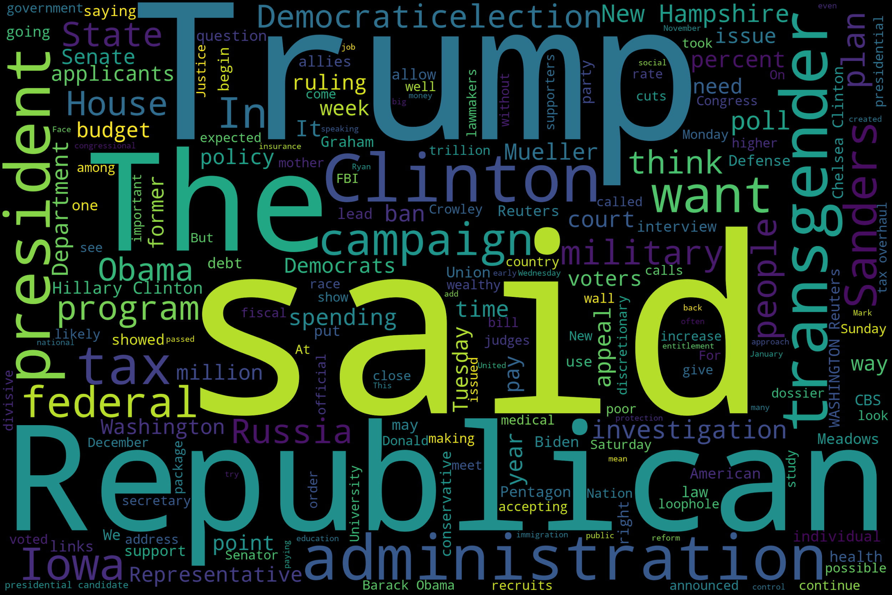
Dataset
Two sets of article instances
21,417 True & 23,481 fake article instances.
Source: Kaggle [1]
Applications: Media and Journalism fake article detection for trust building.
Each set has 4 columns. Title and text of the article, subject of the article and date.
Time-series data with date column.

Slide 5
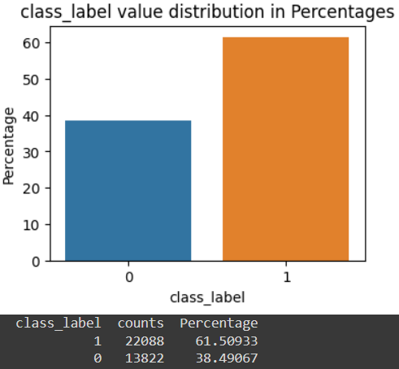
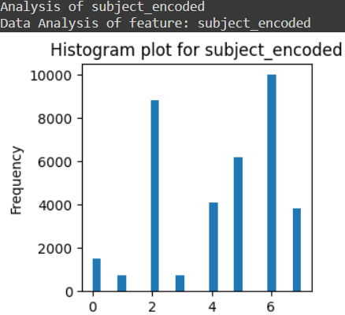
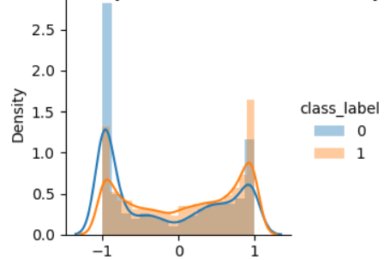
Data Preprocessing & Visualization
Merging of datasets, labeling classes (1- fake and 0- genuine).
Standard datetime format conversion, removal of duplicates and null values, sorting based on date.
Visualization, data imbalance and correlation checks.
Train-test split for train, validation and test respectively
Label encoding for categorical features (subject).
Scaling (standard scaler)
Prepare Text Data for GloVe Embedding (Sentence tokenization, letter casing conversion, word tokenization, stop word removal and appending the cleaned words to train and test lists)
Removed subject column even though the correlation is high, as it makes the model biased.

Slide 6
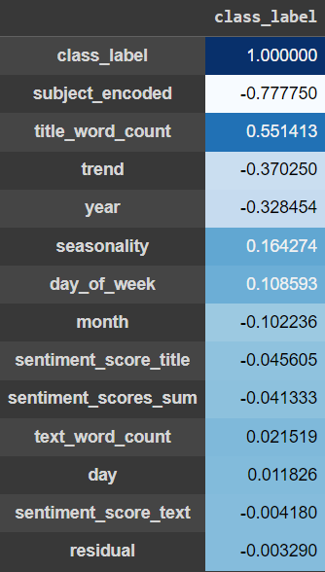
Feature Engineering
Feature extraction involved extracting features related to time, such as day, day of the week, month and year from the datetime feature.
Word counts of both article title and text.
Extraction of time-series based features from date feature:
Trend: It captures the overall direction in which the time series is moving.
Seasonality: Represents regular patterns or cycles in the time series repeating at fixed intervals.
Residual: noise, capture the random fluctuations or variability in the time series
Sentiment scores for both title and text features.
Feature Crosses: Combine multiple features to create new meaningful ones. Aggregated sentiment score of title and text to create a new feature, by adding up the two features (sentiment_scores_sum).
GloVe embeddings (GloVe: Global Vectors for Word Representation)
Unsupervised learning algorithm for obtaining vector representations for words.
Provides a way to represent words as vectors, capturing their semantic relationships based on how often they appear together.
Used GloVe 100 dimension pre-trained word embeddings.
Notes:
Out of different score combining strategies like Weighted average, product, difference, product, threshold values and sum, sum has been chosen for combining both 'sentiment_score_title' and 'sentiment_score_text', as it is the simplest and gives more insight while giving equal importance to both the columns, when compared to product or difference, where the result could be far off from the individual column values.
GloVe aims to represent words in a way that their vector operations reflect their meanings. It learns by analyzing how frequently words co-occur (appear together) in sentences. Words that often appear together or have similar meanings are closer to each other in this space. This representation is valuable for understanding the meanings and relationships between words in natural language, making it a powerful tool in NLP applications. Each word in a large dataset is assigned a unique vector in a high-dimensional space. Words that often appear together or have similar meanings are closer to each other in this space. For example, "king" and "queen" might be closer because they share a similar context.
It involves creating a co-occurrence matrix that captures word relationships. The model then optimizes vectors to minimize the difference between the dot product of vectors and the logarithm of the observed word co-occurrence probabilities.
After training, each word ends up with a vector representation. These vectors encode semantic information, capturing relationships and similarities between words.
The file "glove.6B.100d.txt" is a text file that contains pre-trained GloVe (Global Vectors for Word Representation) word embeddings.
glove: This indicates that the embeddings are generated using the GloVe algorithm.
6B: The training data used to create these embeddings includes a corpus with a vocabulary of 6 billion tokens (words).
100d: The vectors in this file have a dimensionality of 100. Each word is represented as a vector with 100 numerical values.
So, "glove.6B.100d.txt" contains pre-trained word vectors, where each line in the file corresponds to a different word, and the values in each line represent the 100-dimensional vector associated with that word.

Slide 7
Algorithms used
Random Forest
LSTM
RNN

Slide 8
Model Development
Training:
Used time series split for cross-validation (time-series data).
Hyperparameter tuning using Bayes search performed using validation data for Random Forest.
Grid search for LSTM and RNN.
Implemented all algorithms with and without oversampling (ADASYN). Although oversampling in this case is optional, as there is not a lot of class imbalance.
Used pipeline for following the sequence of splitting, ADASYN sampling and then algorithm implementation, to avoid overfitting and data leakage while performing cross validation.
Chose the best parameter configuration from hyperparameter tuning based on F1-score (primary metric being used for binary classification for imbalanced data).
Fitted the model with best combination of parameters, with train data.

Slide 9
Evaluation and Results
Scores - Classification Report
ROC and PR plots
Confusion matrices

Slide 10
Evaluation
Testing:
Predictions obtained on x_test as y_pred and compared with y_test.
Performance evaluation metrics chosen:
F1-Score. Primary metric for imbalanced binary classification, as it combines precision and recall.
Classification report including F1-score, Precision, Recall and Accuracy.
Confusion matrix to view TP, TN, FN and FP.
ROC (Receiver Operating characteristic curve) and PR (Precision-Recall) plots.
Observe AUC (Area Under ROC Curve)
In this case, having least number of false negatives is desired when compared to false positives.

Slide 11
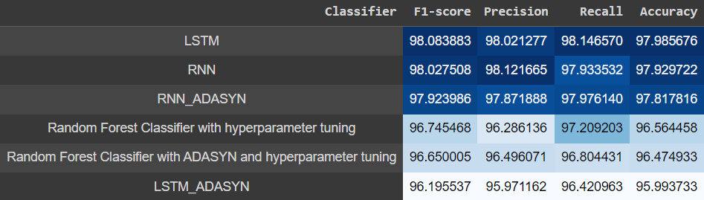
Results: Scores - Classification Report
Vision Transformer
Best Recall and F1-Score by LSTM.

Slide 12
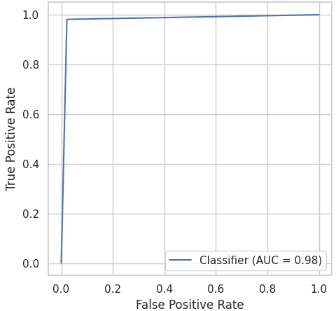
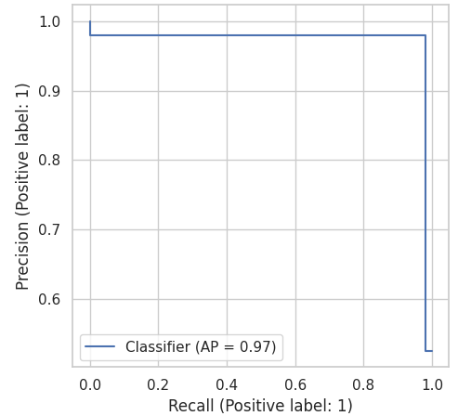
Results: ROC and PR Plots (LSTM)
Receiver Operating Characteristics
Precision Recall curve
Area Under Curve (AUC): 98%

Slide 13
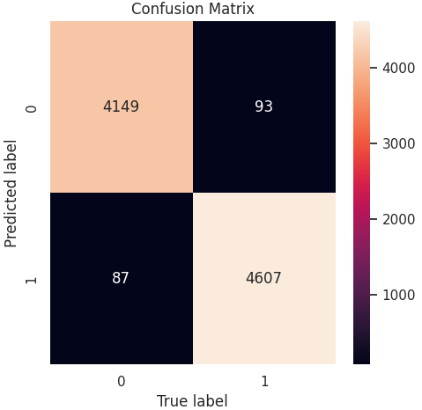
Results: Confusion Matrix (LSTM)
For LSTM:
True Positives: 4607
True Negatives: 4149
False Positives: 87
False Negatives: 93

Slide 14
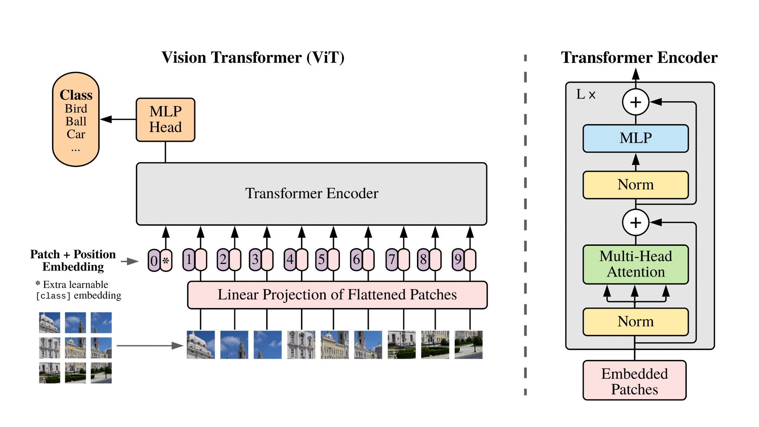
Future Work
A single technique is not good for all the applications, could expand the research with a variety of other models.
Utilize time-series techniques like rolling window to enhance the prediction quality.
Transformers – a new buzzword (ChatGPT, and other GenAI models being widely used)
Implement transformers specially used for NLP tasks. But work better with more data.
Attention mechanisms further help with text detection and classification.

Slide 15
Conclusion
Most implementations with this dataset use shuffle or stratify, which should be avoided while dealing with time-series data, as preference has to be given to data order. But, due to the nature of the data, stratify had to be implemented to achieve better performance.
In this domain of classification, having minimum false negatives takes priority over false positives, as false positives could further be investigated manually. Recall* & F1-score*
More applications in this domain: Social media misinformation control, political manipulation prevention, plagiarism detection in academics, phishing detection in cybersecurity context, countering fake articles related to health, etc.
Fake article detection plays a vital role in maintaining trust, preventing the spread of misinformation, and upholding the quality and integrity of information across various domains.
Notes:
When performing splitting of train and test after sorting, the imbalance of 0s and 1s is large.

Slide 16
References
[1] Fake and real news dataset: https://www.kaggle.com/datasets/clmentbisaillon/fake-and-real-news-dataset/data
[2] Ashish Vaswani, Noam Shazeer, Niki Parmar, Jakob Uszkoreit, Llion Jones, Aidan N. Gomez, Lukasz Kaiser, Illia Polosukhin., “Attention Is All You Need”, https://doi.org/10.48550/arXiv.1706.03762
[3] NLP — Word Embedding & GloVe
https://jonathan-hui.medium.com/nlp-word-embedding-glove-5e7f523999f6
[4] Intuitive Guide to Understanding GloVe Embeddings
https://towardsdatascience.com/light-on-math-ml-intuitive-guide-to-understanding-glove-embeddings-b13b4f19c010
[5] How to Develop LSTM Models for Time Series Forecasting
https://machinelearningmastery.com/how-to-develop-lstm-models-for-time-series-forecasting/

Slide 17
Thank you.

